Slide 1


Fitting integrated species distribution models using mgcv
Elliot Dovers (he/him)
with Gordana Popovic, Jakub Stoklosa, David Warton
Sch. Mathematics & Statistics
I would like to acknowledge the Gumbaynggirr people who are the Traditional Custodians of the land on which this research was conducted, and pay my respects to elders past, present and emerging.

Slide 2
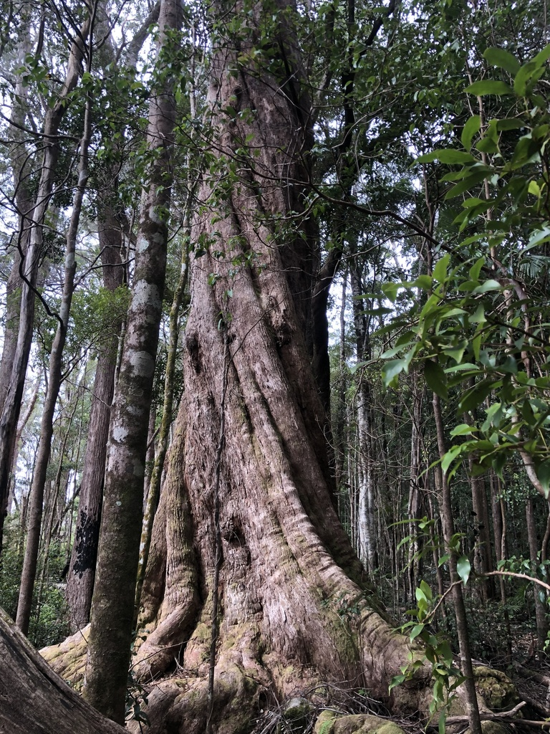
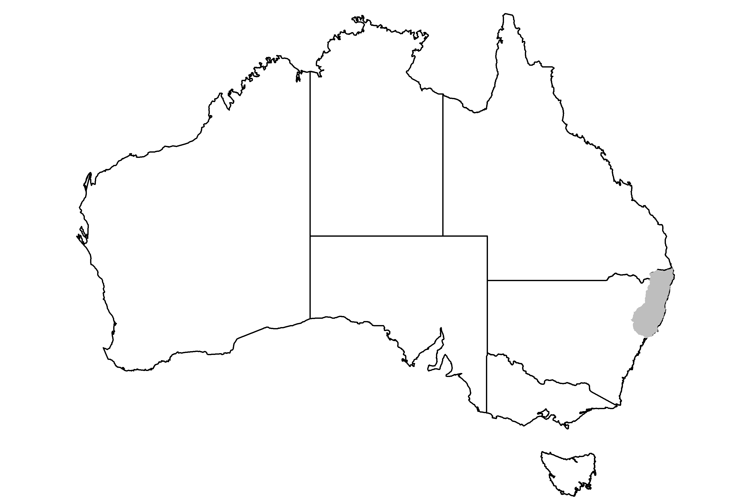
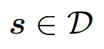
Eucalyptus campanulata
(New England Blackbutt)
© Samuel Frankel

Slide 3
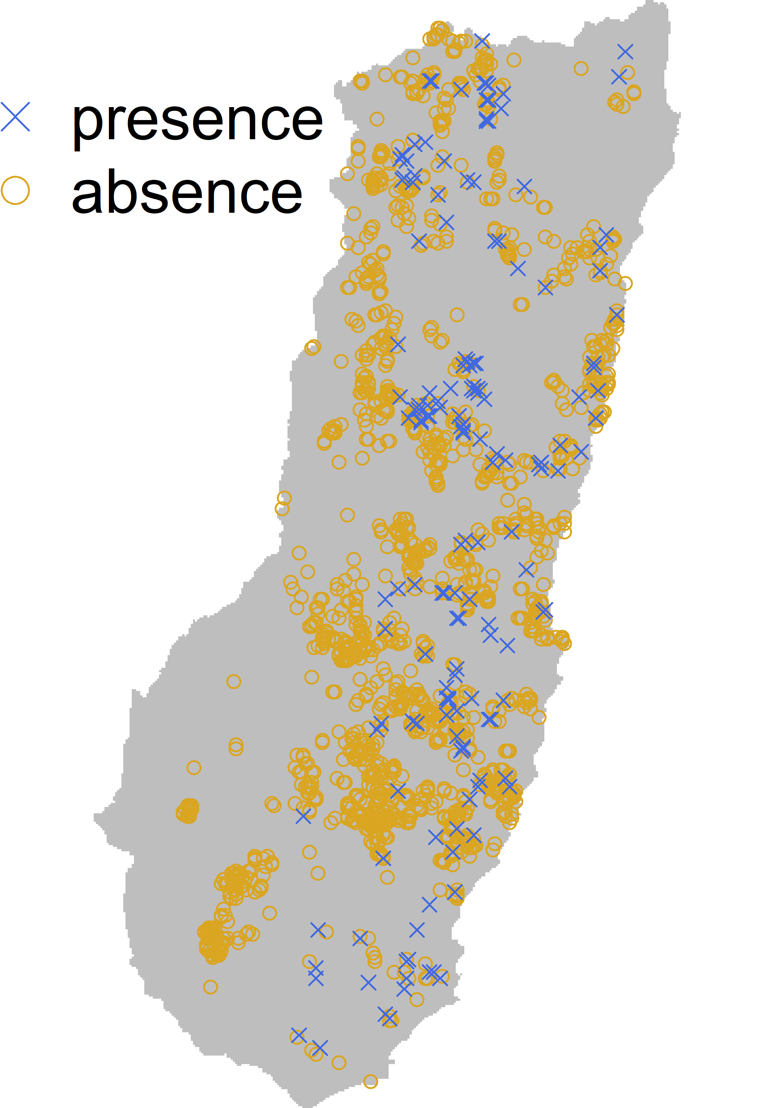
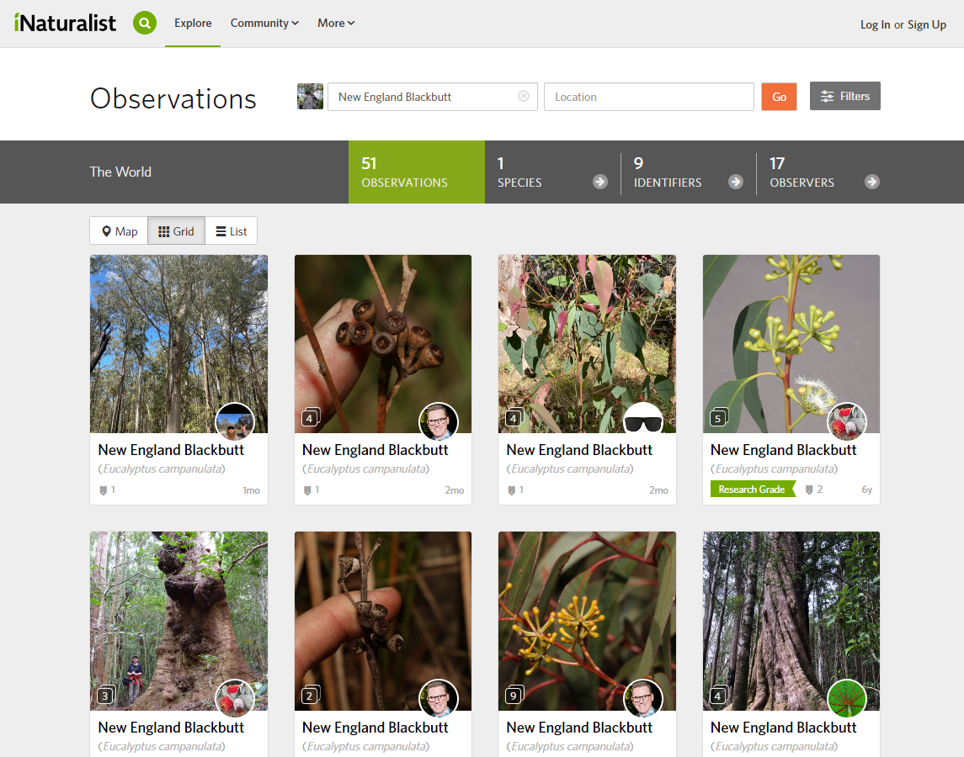
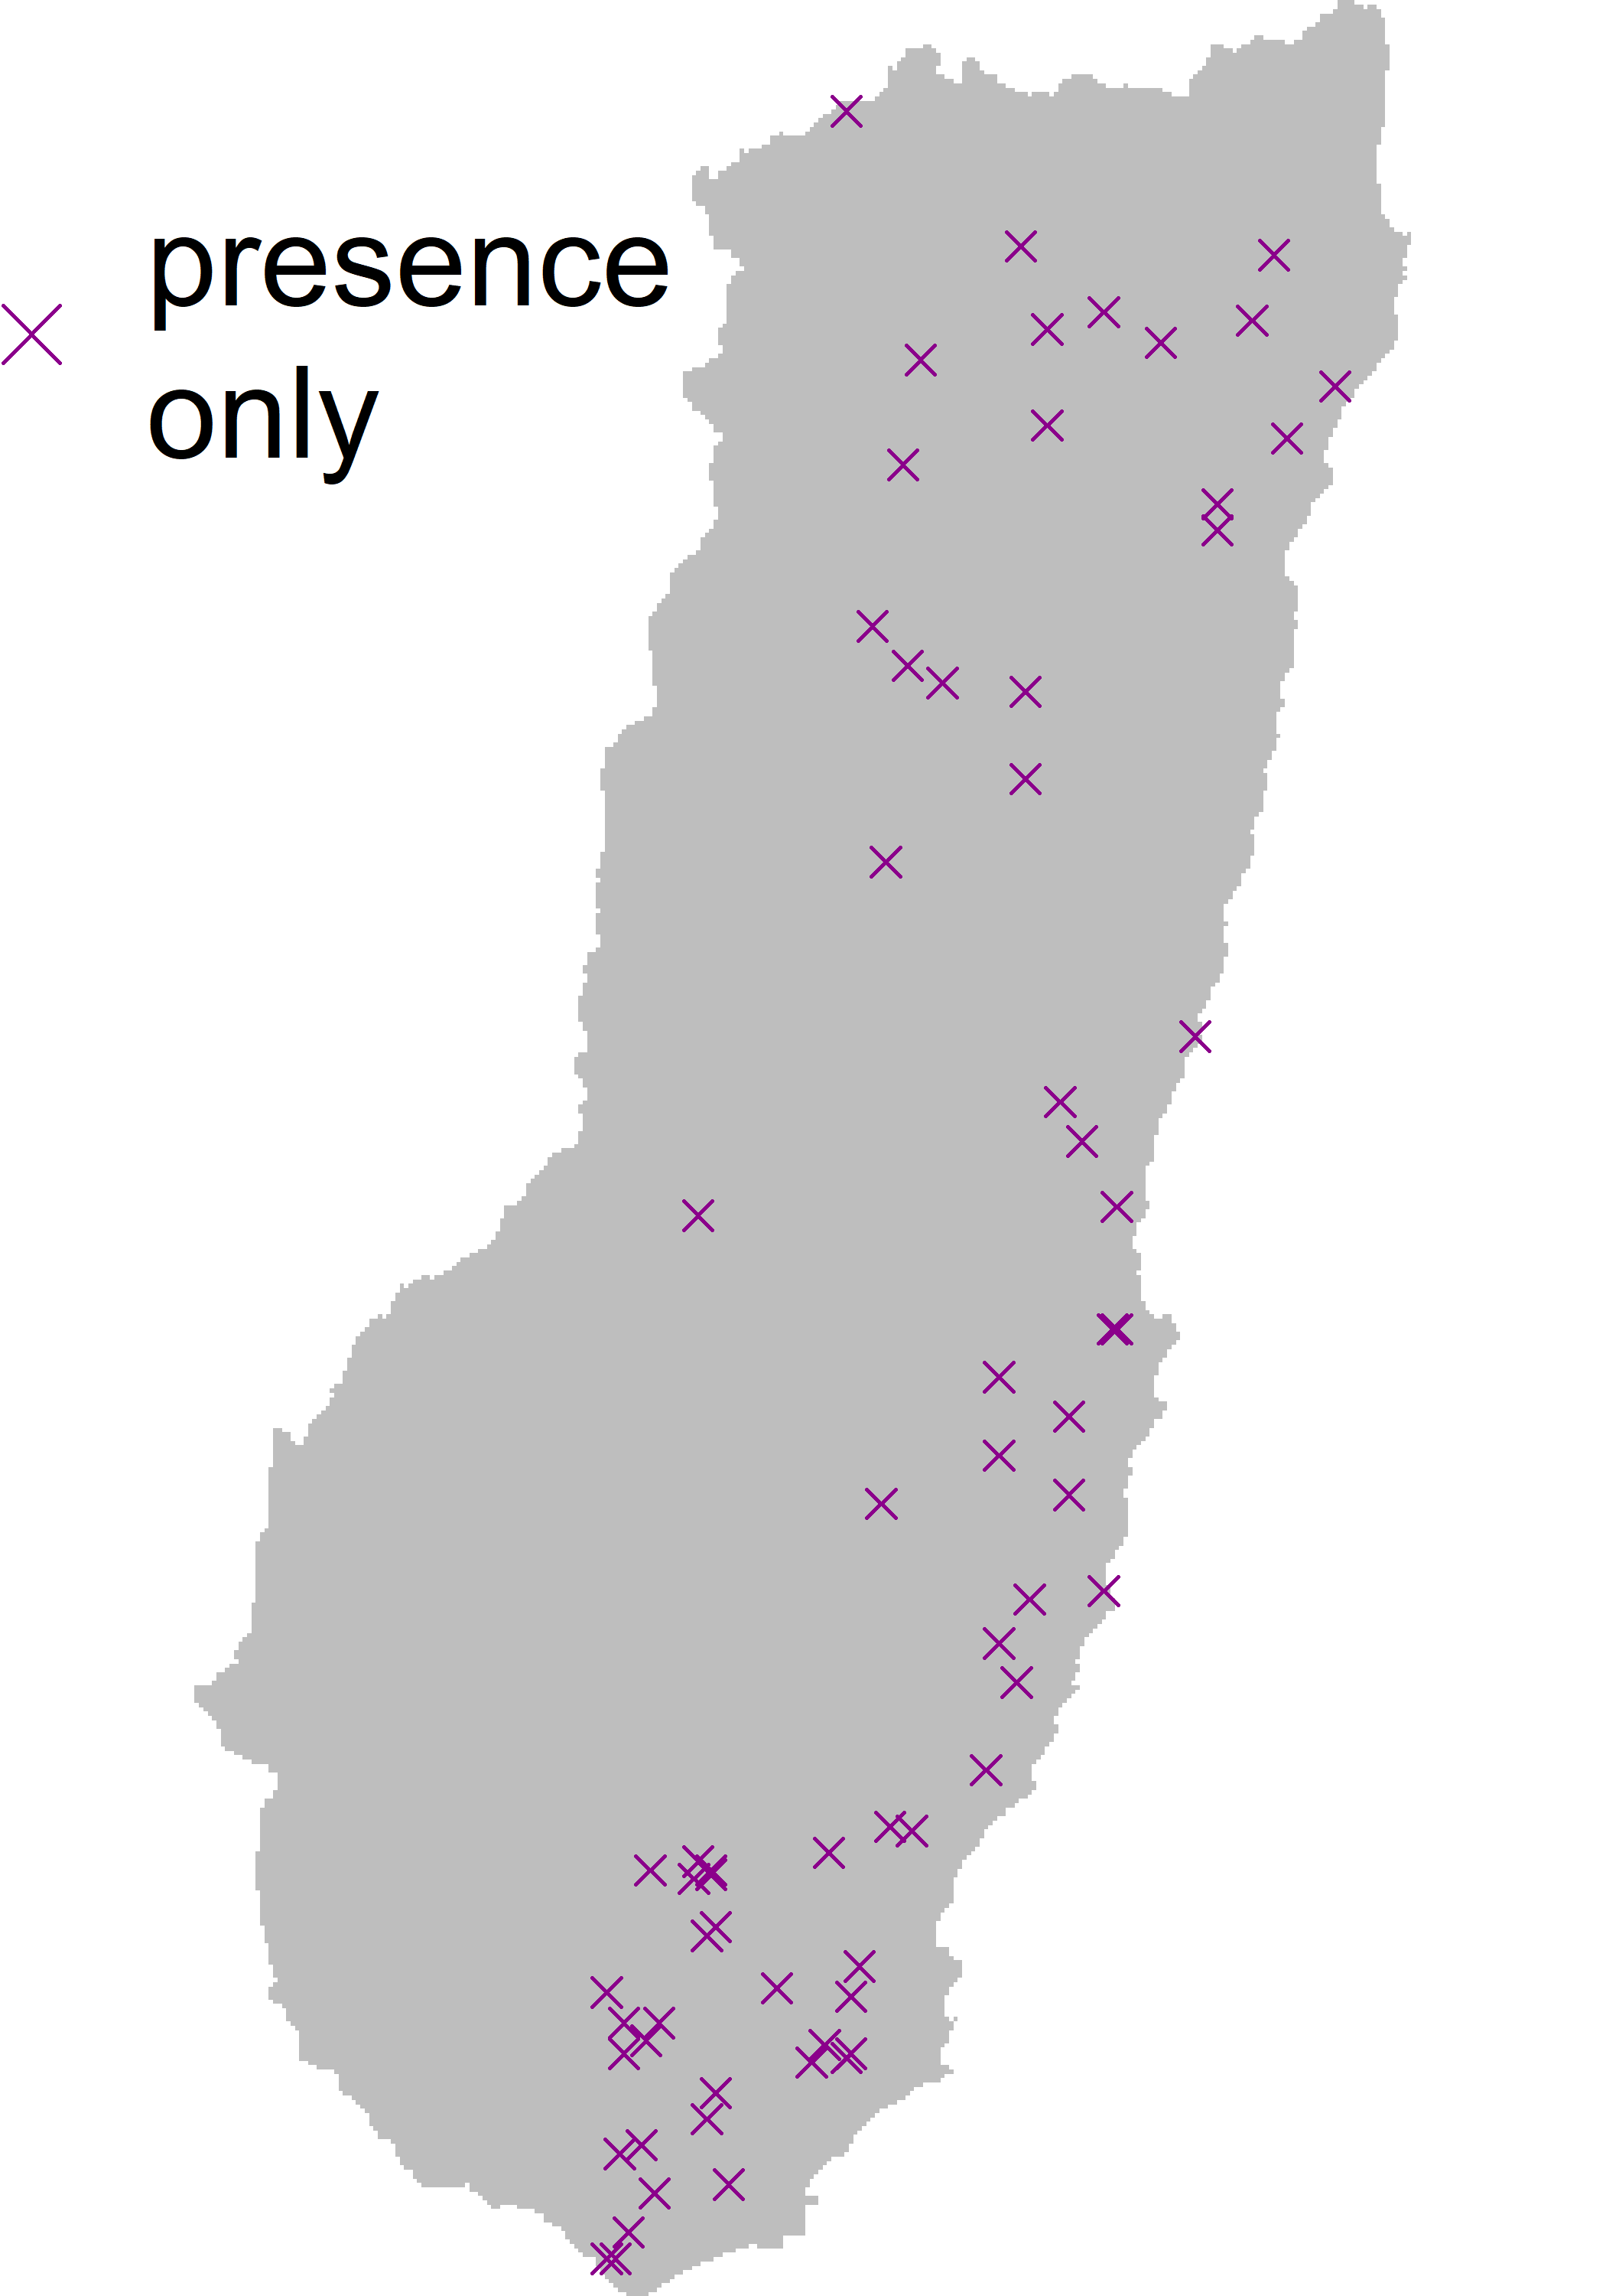
An Integrated Species Distribution Model
Vegetation Survey

Slide 4
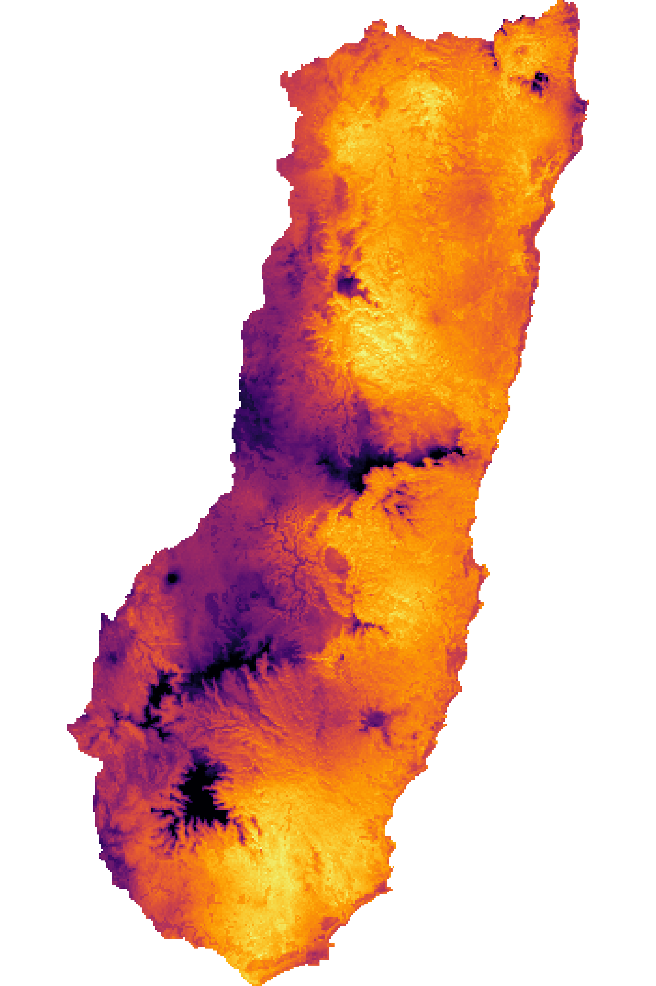
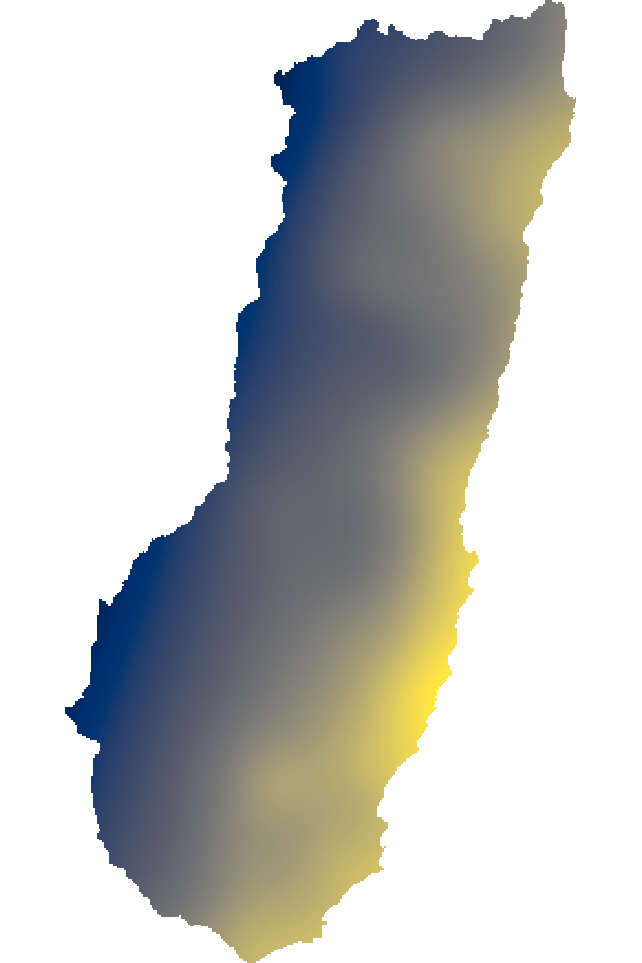
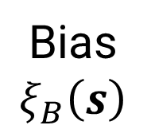
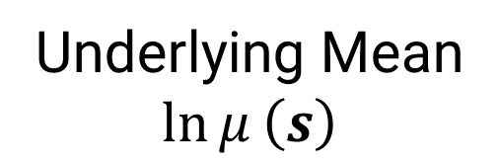
An Integrated Species Distribution Model
Underlying Mean
$$\ln{μ}\left(s\right)$$
Bias
$$ξ_{B}\left(s\right)$$

Slide 5
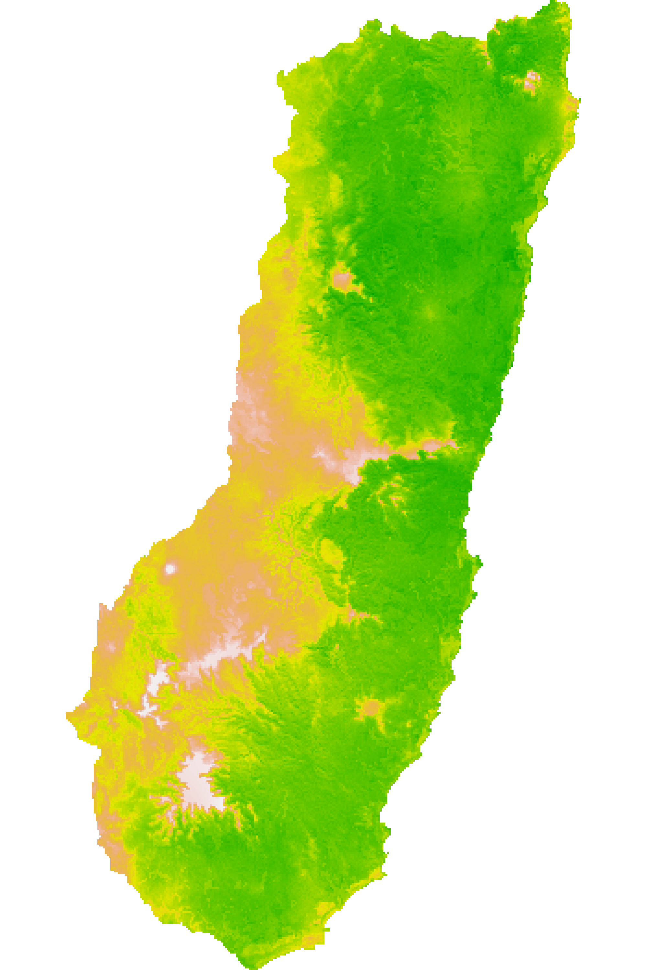
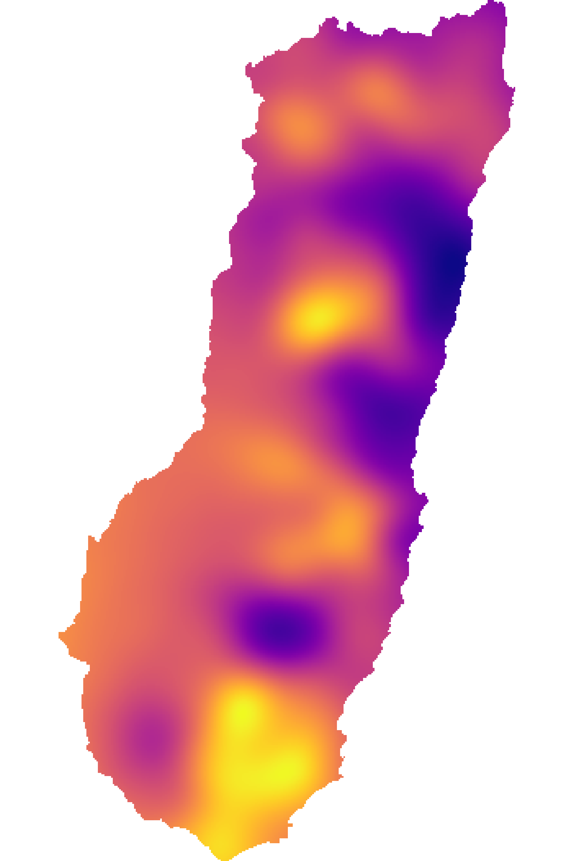
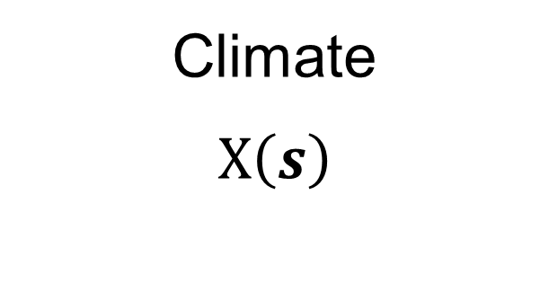
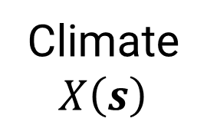
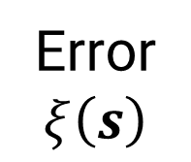
An Integrated Species Distribution Model
Underlying Mean
$$\ln{μ}\left(s\right)$$
Climate
$$X\left(s\right)$$
Error
$$ξ\left(s\right)$$

Slide 6
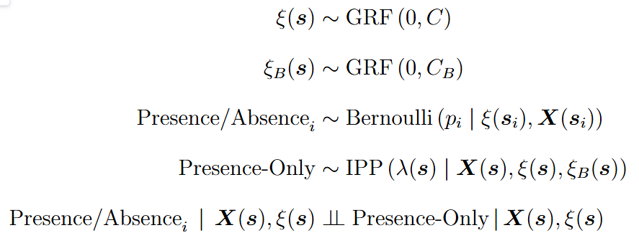
An Integrated Species Distribution Model

Slide 7
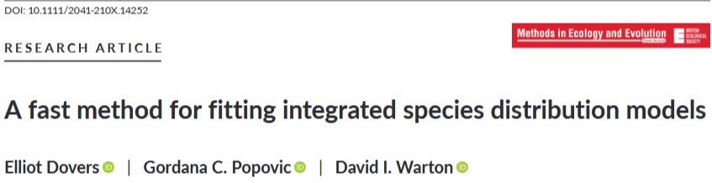
ISDMs often need both Error & Bias Fields
See also:
Simmonds et al. (2020) Ecography
Patterson et al. (2025) Methods in Ecology and Evolution

Slide 8
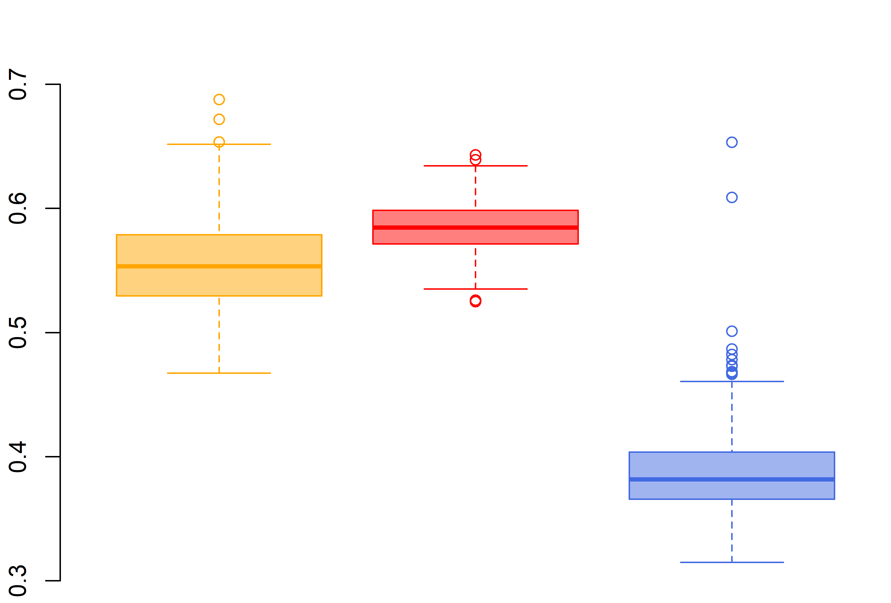
ISDMs need both Error & Bias Fields
Error Only
No Fields
Better estimate of Underlying Mean
&
But these latent fields make the ISDM harder to fit!

Slide 9
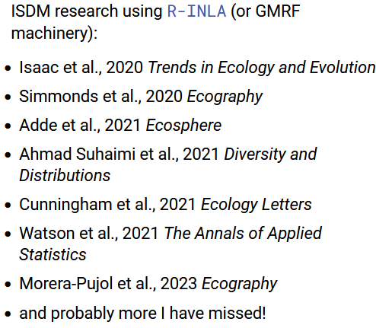
R-INLA is used a lot for fitting ISDMs

Slide 10
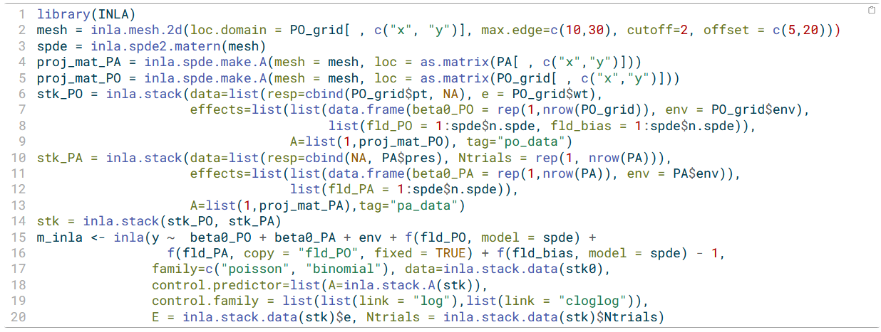
But R-INLA can be tricky to use!
Friendlier alternatives/wrappers: RISDM, pointedSDMs, spOccupancy
We suggest: GAMs offer a quick and easy solution to fit fields!

Slide 11
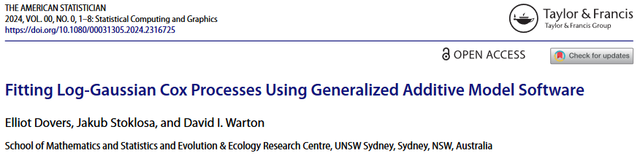
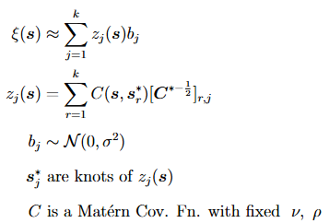
Fields with GAMs
s(x,y)
See also: Kammann & Wand (2003)

Slide 12
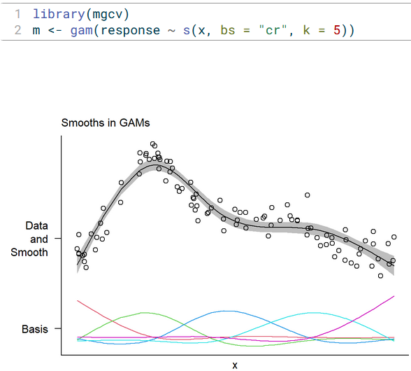
Basis Functions
Fields with GAMs
s(x,y)

Slide 13
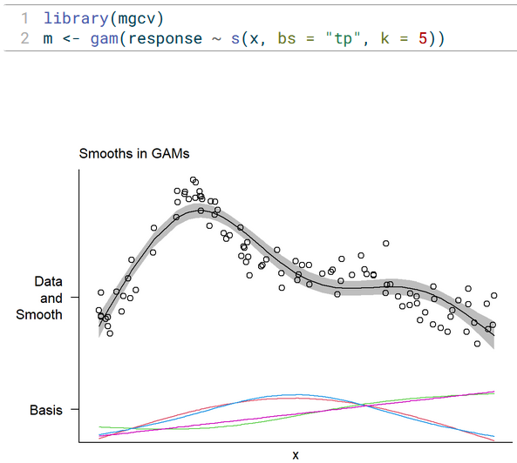
Basis Functions
Fields with GAMs
s(x,y)

Slide 14
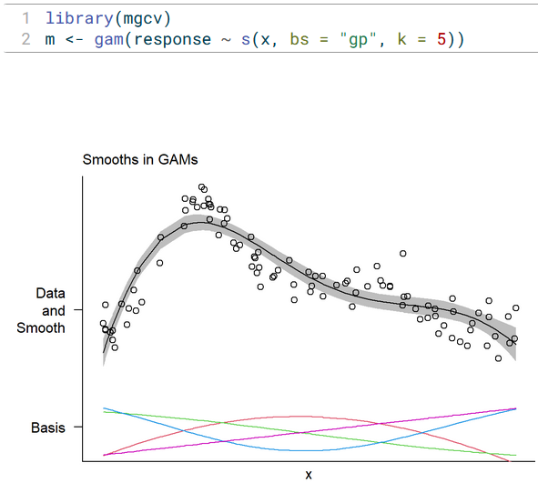
Basis Functions
Fields with GAMs
How Many
s(x,y)

Slide 15
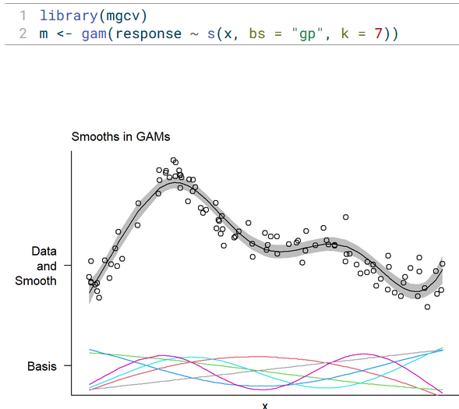
Fields with GAMs
How Many
s(x,y)

Slide 16
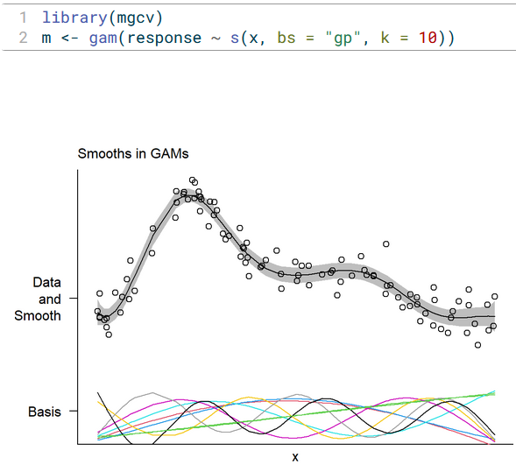
Fields with GAMs
How Many
s(x,y)

Slide 17
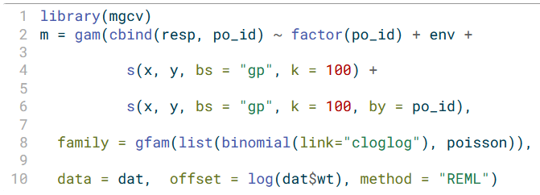
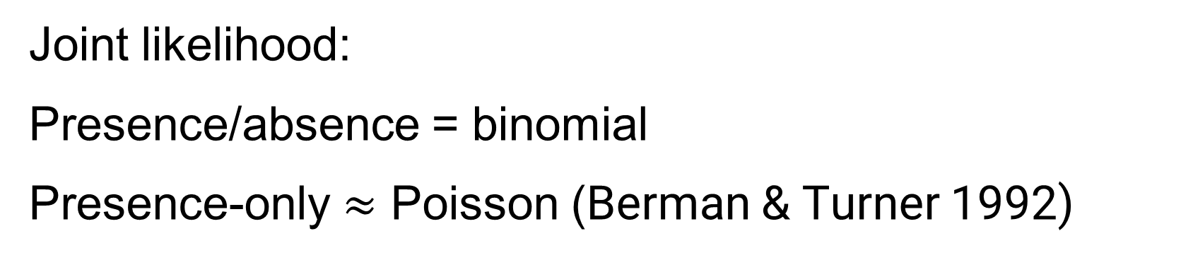
ISDMs with GAMs (using mgcv)
Climate
Error
Bias

Slide 18
scampr is a speed focused version
https://github.com/ElliotDovers/scampr

Slide 19
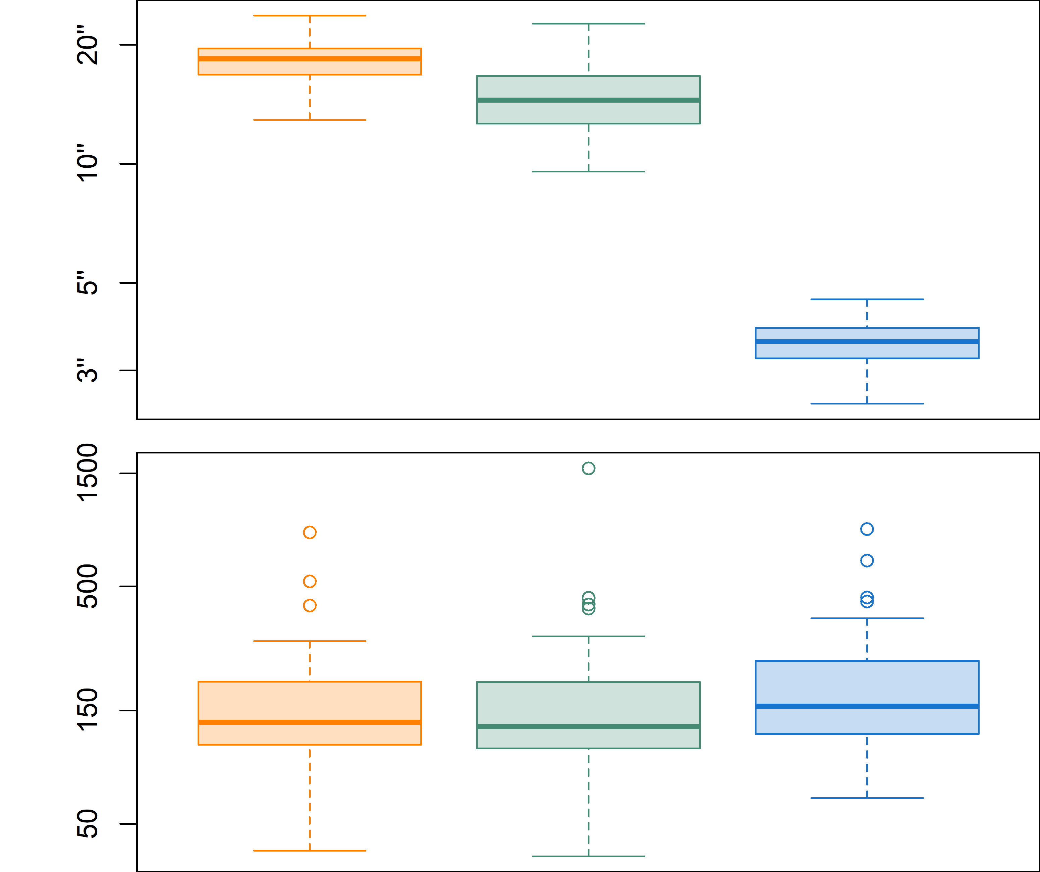
Estimates of the underlying mean
Faster
mgcv usually a little faster and as accurate
scampr sacrifice a little accuracy for much faster
More
accurate
R-INLA
mgcv
scampr

Slide 20
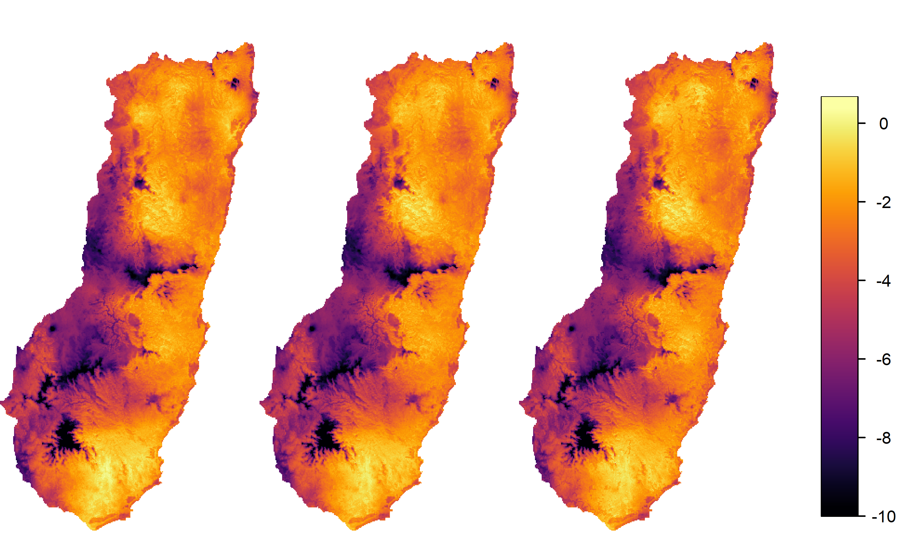
Estimates of the underlying mean
R-INLA
scampr
mgcv

Slide 21
Thanks for listening
Watch out for paper on fitting ISDM using mgcv
See our paper, Dovers et al. (2024) on ISDM for:
Demonstration of improved OOS prediction for 29 species of flora Northern NSW
More extensive simulation results
Contact:
e.dovers@unsw.edu.au
This work was supported by the Australian Research Council Discovery Project scheme (DP210101923)

